Slide 1
CREDO 1. ‘I believe in God, the Father Almighty, Creator of heaven and earth.’

Slide 2
Do you agree?
1. ‘What matters is that we know God, not know about God.’
2. ‘Why do we need the Creed when we have the Bible?’

Slide 3
Plan for today.
A. Why emphasise Creed today?
B. How was it used in Early Church?
C. Why this structure?
D. What is Faith?
E. Who is Father Almighty?
Notes:
Creed comes from the Latin word Credo – which means I believe

Slide 4
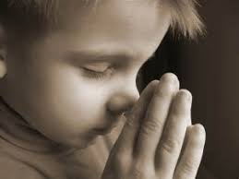
A. Why emphasise Creed today?
1. ‘What matters is that we know God, not know about God. All we need is simple faith. Why do we need all that doctrine?’
Wedge: Experience of faith vs revelation of God

Slide 5
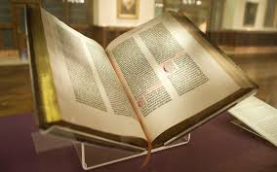
A. Why emphasise Creed today?
2. ‘Why do we need the Creed when we have the Bible? We should follow the Bible, not man-made religion.’
Bible is God’s Word in human words.
Wedge: Creed vs Canon (of Scripture)
Note: Sola Scriptura not Solo Scriptura
Notes:
2. What is our doctrine of inspiration?
e.g. is it like the Quran – dictation? This is mechanical inspiration
God’s word in human words – humanity is dignified not suppressed.
Drives a wedge between Creed and Canon.
Creed serves as a succinct summary of the Christian faith.

Slide 6
B. How it’s used in Early Church
1. Preserving
2. Guiding
3. Confessing

Slide 7
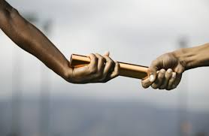
B. How it’s used in Early Church
1. Preserving
Christianity is a Traditioned Faith
Jesus and the OT Tradition
Matthew 5:17 Do not think that I have come to abolish the Law or the Prophets; I have not come to abolish them but to fulfill them.

Slide 8
B. How it’s used in Early Church
1. Preserving
Christianity is a Tradition Faith
The Apostolic Tradition
2 Thess 2:15: So then, brothers, stand firm and hold to the traditions that you were taught by us, either by our spoken word or by our letter.
Jude 3: …contend for the faith that was once for all delivered to the saints.
Notes:
Christianity is a traditioned faith / faith isn’t just an inner spark but reception of something passed down.
- when Jesus came, he did not come to abolish the law but to fulfill it
Verse references
Jude 3: …contend for the faith that was once for all delivered to the saints.
2 Timothy 1:13–14: Follow the pattern of the sound words that you have heard from me… Guard the good deposit entrusted to you.
1 Corinthians 15:3–5: For I delivered to you as of first importance what I also received…
2 Thessalonians 2:15: So then, brothers, stand firm and hold to the traditions that you were taught by us, either by our spoken word or by our letter.
Romans 6:17: …you obeyed from the heart the form of teaching to which you were entrusted.
Ephesians 2:19-20 19 So then you are no longer strangers and aliens, but you are fellow citizens with the saints and members of the household of God, 20 built on the foundation of the apostles and prophets, Christ Jesus himself being the cornerstone,

Slide 9
B. How it’s used in Early Church
1. Preserving
“rule of faith” (regula fidei)
=Apostolic Tradition
The ‘rule of faith’ is the apostolic summary of core Christian beliefs, guiding Scripture interpretation, doctrine, and church life.

Slide 10
B. How it’s used in Early Church
1. Preserving
How was this rule of faith passed on?
Oral Tradition and Practices
Formal wording came along later:
Old Roman Creed -> Apostles Creed
Canonisation of Scriptures
Notes:
The rule of faith was fluid and oral, used to guard apostolic teaching, especially against heresy.
The Creed became a fixed version of the rule, especially for
The rule of faith came first, as a summary of apostolic teaching, transmitted orally.
The Creed is a formalized instance of the rule, codified for confession and instruction.
baptismal confession and catechesis.

Slide 11
B. How it’s used in Early Church
1. Preserving
Creed served as doctrinal standard to teach and defend
Marked boundary against attacks of early heresies.
Thus contents of Creed focused on certain issues.

Slide 12
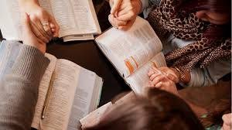
B. How it’s used in Early Church
2. Guiding
Creed guided the Church’s interpretation of Scripture
Since it served as a succinct summary of the Scriptures
Note: Sola Scriptura not Solo Scriptura
Simply quoting Bible is not enough
E.g. Arians
Notes:
Guides our reading of Scripture.
How we understand the faith with all the saints.
As mentioned in earlier pt, heretics often quote more bible the orthodoxy.

Slide 13
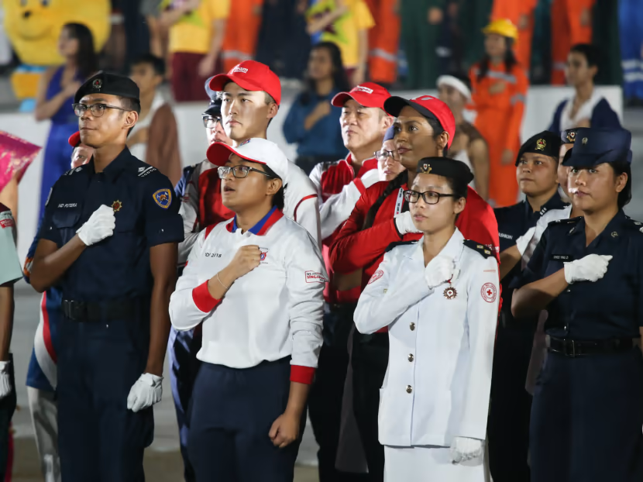
B. How it’s used in Early Church
3. Confessing
Question: How does saying the pledge make you feel?
Notes:
Like saying the pledge
It’s declaration of identity marker
It’s a speech act - something is changed by the declaration
e.g. your conviction; the conviction of others.
Of course it is possible to recite the apostles creed in a mindless way

Slide 14
B. How it’s used in Early Church
3. Confessing
Question: How does saying the pledge make you feel?
When we declare publicly, we are affirming our part in a story.
Notes:
Like saying the pledge
It’s declaration of identity marker
It’s a speech act - something is changed by the declaration
e.g. your conviction; the conviction of others.
Of course it is possible to recite the apostles creed in a mindless way

Slide 15
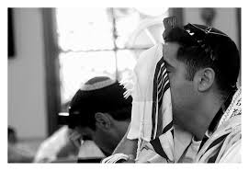
B. How it’s used in Early Church
3. Confessing
Biblical Faith as always been confessional
OT
The Shema
Deut 6:24-25 Hear, O Israel: the LORD our God, the LORD is one.” You shall love the LORD your God with all your heart, and with all your soul, and with all your might…
Notes:
OT
Attributes: The formula “gracious and compassionate, slow to anger, abounding in love” is a recurring confession of the attributes of God (compare Exod 34:6; Neh 9:17; Pss 86:15; 103:8; 145:8; Joel 2:13; Jonah 4:2).
Creator: There is also the prominent confession of God as creator (2 Kgs 19:15; Psa 95; Exod 20:8–11; Deut 5:12–15).
Shema: Deuteronomy 6:4–7, known as the Shema, calls Israel to profess the only true and universal God, His works, and His commandments (compare Deut 6:1–3). The Decalogue—outlining the nature and character of the living God and spelling out Israel’s responsibilities to Him—precedes the Shema and embodies the covenant relationship (Deut 5:6–21; compare Exod 20:2–17). The Shema can thus be seen as an encapsulation or distillation of the entire covenant text.
The Shema is more than an individual testimony or confession of faith; it is formative for the identity of God’s people. As a confession of faith in the covenant God and his law, the Shema holds an important place in the life of Israel. In the New Testament, Jesus cites the Shema (and its companion in Lev 19:18) as the fundamental tenet of Jewish faith (Matt 22:34–40; Mark 12:28–31; Luke 10:25–28). However, Gerstenberger notes that while the Shema might have some affinity to a creed, it is not a fixed creed in the formal sense of later Christian tradition (Gerstenberger, “Glaubensbekenntnis(se),” 386).
Westermann notes that in ancient Israel, in the context of a multi-religious environment, the decision to give thanks to God and sacrifice to Him is a confession in itself (Westermann, “Bekenntnis,” 1247). Through these actions, the Israelites renounce false gods and declare their allegiance and loyalty to God alone (Gen 35:1–3; Josh 24:23; Judg 10:16; 1 Sam 7:3–4; Hos 14:3; Ezek 20:7; 2 Chr 33:15).
NT
In confessing “Jesus is Lord” (Rom 10:9; 1 Cor 12:3; 8:6), early Christians acknowledged Jesus in the same terms as Yahweh of the Old Testament.
Paul speaks of the “form of teaching” delivered to converts (Rom 6:17), and reminds Timothy of “the good [beautiful] confession” he had made in sight of many witnesses (1 Tim 6:12)
The New Testament attests to early Christian confession through: e.g singing (Phil 2:5–11)
Christological affirmations in the New Testament declare the lordship of Jesus Christ and the reality of His resurrection (1 Cor 15:3–4; Rom 10:9–10; 4:24; 8:34; 1 Tim 3:16). Other passages confess both God and Christ (1 Cor 8:6), and some statements affirm Father, Son, and Holy Spirit (Matt 28:19; 2 Cor 13:14)
Yet while the New Testament includes individual and corporate confessions and some repeated slogans (e.g., “Jesus is Lord”), it likely contains no formal, fixed creeds of the kind that were developed in later centuries. One possible exception to this might be 1 Cor 15:3–5, which many scholars regard as an early creed quoted by Paul
Frank M. Hasel, “Creeds and Confessions,” in The Lexham Bible Dictionary, ed. John D. Barry et al. (Bellingham, WA: Lexham Press, 2016).

Slide 16
B. How it’s used in Early Church
3. Confessing
Biblical Faith as always been confessional
NT
Confessing “Jesus is Lord” (Rom 10:9; 1 Cor 12:3; 8:6, Phil 2:5–11)
Confessing Christ’s resurrection (1 Cor 15:3–4).
Confessing Triune God (Matt 28:19; 2 Cor 13:14)
Notes:
OT
Attributes: The formula “gracious and compassionate, slow to anger, abounding in love” is a recurring confession of the attributes of God (compare Exod 34:6; Neh 9:17; Pss 86:15; 103:8; 145:8; Joel 2:13; Jonah 4:2).
Creator: There is also the prominent confession of God as creator (2 Kgs 19:15; Psa 95; Exod 20:8–11; Deut 5:12–15).
Shema: Deuteronomy 6:4–7, known as the Shema, calls Israel to profess the only true and universal God, His works, and His commandments (compare Deut 6:1–3). The Decalogue—outlining the nature and character of the living God and spelling out Israel’s responsibilities to Him—precedes the Shema and embodies the covenant relationship (Deut 5:6–21; compare Exod 20:2–17). The Shema can thus be seen as an encapsulation or distillation of the entire covenant text.
The Shema is more than an individual testimony or confession of faith; it is formative for the identity of God’s people. As a confession of faith in the covenant God and his law, the Shema holds an important place in the life of Israel. In the New Testament, Jesus cites the Shema (and its companion in Lev 19:18) as the fundamental tenet of Jewish faith (Matt 22:34–40; Mark 12:28–31; Luke 10:25–28). However, Gerstenberger notes that while the Shema might have some affinity to a creed, it is not a fixed creed in the formal sense of later Christian tradition (Gerstenberger, “Glaubensbekenntnis(se),” 386).
Westermann notes that in ancient Israel, in the context of a multi-religious environment, the decision to give thanks to God and sacrifice to Him is a confession in itself (Westermann, “Bekenntnis,” 1247). Through these actions, the Israelites renounce false gods and declare their allegiance and loyalty to God alone (Gen 35:1–3; Josh 24:23; Judg 10:16; 1 Sam 7:3–4; Hos 14:3; Ezek 20:7; 2 Chr 33:15).
NT
In confessing “Jesus is Lord” (Rom 10:9; 1 Cor 12:3; 8:6), early Christians acknowledged Jesus in the same terms as Yahweh of the Old Testament.
Paul speaks of the “form of teaching” delivered to converts (Rom 6:17), and reminds Timothy of “the good [beautiful] confession” he had made in sight of many witnesses (1 Tim 6:12)
The New Testament attests to early Christian confession through: e.g singing (Phil 2:5–11)
Christological affirmations in the New Testament declare the lordship of Jesus Christ and the reality of His resurrection (1 Cor 15:3–4; Rom 10:9–10; 4:24; 8:34; 1 Tim 3:16). Other passages confess both God and Christ (1 Cor 8:6), and some statements affirm Father, Son, and Holy Spirit (Matt 28:19; 2 Cor 13:14)
Yet while the New Testament includes individual and corporate confessions and some repeated slogans (e.g., “Jesus is Lord”), it likely contains no formal, fixed creeds of the kind that were developed in later centuries. One possible exception to this might be 1 Cor 15:3–5, which many scholars regard as an early creed quoted by Paul
Frank M. Hasel, “Creeds and Confessions,” in The Lexham Bible Dictionary, ed. John D. Barry et al. (Bellingham, WA: Lexham Press, 2016).

Slide 17
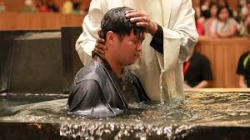
B. How it’s used in Early Church
3. Confessing
Creed originated from baptismal interrogations.
To confess their faith
To Christ and against Satan
Later on became a declaratory Creed, emphasising you are not Arian
Later developed in Apostles Creed
Notes:
Early church writings attest to baptismal interrogations, in which the baptismal candidates are given an opportunity to confess their faith in connection with baptism (Kinzig and Vinzent, “Recent Research”, 542; von Campenhausen, “Das Bekenntnis im Urchristentum”, 228). According to the second-century church father Tertullian, the baptismal candidate would renounce Satan and profess Christian faith in response to a set of three formal questions about belief in God as Father, Son, and Holy Spirit. Hippolytus (ad 215) described the baptismal rite of the church of Rome in comparable language (Stevenson, New Eusebius, 141–43). Cyprian reports a similar practice in Rome. Similar questions are found in Palestine, Cappadocia, and Alexandria (compare Kinzig and Vinzent, “Recent Research,” 542–43).
These confessions of faith at the entrance to church membership were interrogative or dialogical in structure. The baptismal candidate would respond “I believe” to questions, likely adapted from the Trinitarian baptismal formula, about God and His salvific acts (Matt 28:19; Didache 7.1.3; Kinzig and Vinzent, “Recent Research”, 547).
By the mid-fourth century, baptismal questions were changed into a declaratory creed, the so-called Roman Creed, which emerged in connection with the Arian controversy (Kinzig and Vinzent, “Recent Research”, 545–52). The oldest witness to the Roman Creed is Marcellus’ letter to Julius of Rome in ad 340/41. His confession of faith needed the authority of Rome and the apostles in order to guarantee its continuing existence in the liturgy. It was called the Roman Creed partly because its text was composed and approved in Rome. In the seventh century, the first and third articles were extended to become the Apostles’ Creed (Vinzent and Kinzig, “Recent Research,” 559).
Frank M. Hasel, “Creeds and Confessions,” in The Lexham Bible Dictionary, ed. John D. Barry et al. (Bellingham, WA: Lexham Press, 2016).

Slide 18
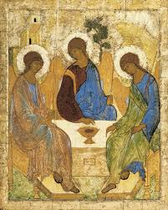
C. Why this structure?
1. Triune Structure
I believe in God the Father Almighty…
And in Jesus Christ, His only Son, our Lord…
I believe in the Holy Spirit…

Slide 19
C. Why this structure?
1. Triune Structure
Why?
Follows Triune order when mentioning Trinity.
‘in the Name of the Father, Son and Holy Spirit’
Doctrine of Trinity is central article of Faith.

Slide 20
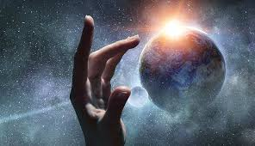
C. Why this structure?
2. Order of Salvation
….Father… Maker of heaven and Earth
…Jesus Christ…born…died…rose again…
…Holy Spirit…Church…life everlasting…

Slide 21
C. Why this structure?
2. Order of Salvation
….Father… Maker of heaven and Earth
Creation
…Jesus Christ…born…died…rose again…
Redemption
…Holy Spirit…Church…life everlasting…
Consummation

Slide 22
C. Why this structure?
2. Order of Salvation
Why?
Not division of labour.
The works of the Trinity are indivisible, but are appropriated to each Person.
The Father plans, the Son accomplishes, the Spirit applies.
Salvation is from the Father, through the Son, by the Holy Spirit.

Slide 23
C. Why this structure?
2. Order of Salvation
Why?
Not division of labour.
E.g. Father, Son and Spirit all involved in Creation
Son - Col 1:16 For by him all things were created, in heaven and on earth…
Spirit - Gen 1:2 And the Spirit of God was hovering over the face of the waters.

Slide 24
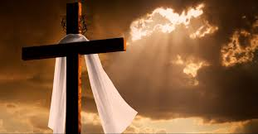
C. Why this structure?
3. Christological Emphasis
And in Jesus Christ, His only Son, our Lord, who was conceived by the Holy Spirit, born of the Virgin Mary,
suffered under Pontius Pilate, was crucified, died, and was buried.
On the third day, He rose again from the dead.
He ascended into heaven and is seated at the right hand of God, the Father Almighty.
From there, He will come to judge the living and the dead.

Slide 25
C. Why this structure?
3. Christological Emphasis
Why?
Deals with gnostic heresies.
against denial of his humanity
Reflects Jesus Christ as Word of God.
c.f. article on Holy Spirit

Slide 26
Pause.

Slide 27
‘I believe in God, the Father Almighty, Creator of heaven and earth.’
D. What is Faith?
E. Who is Father Almighty?

Slide 28
D. What is Faith?
1. Faith – Secular Notions
If a friend said this to you in conversation and gave you a chance to respond, what will you say?
‘Faith isn’t about truth—it’s about what works. Humans believe in shared stories, not because they’re factually true, but because they help us live, cooperate, and find meaning. Faith holds communities together, gives people hope, and inspires sacrifice. Like belief in nations or human rights, it matters less whether it’s real and more that it’s useful.’
Notes:
There’s a change in western secular understandings of faith.

Slide 29
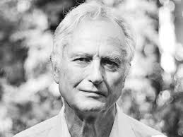
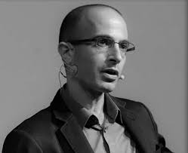
D. What is Faith?
1. Faith – Secular Notions
Shift in secular notions of faith.
From: Faith as irrational and harmful
New Atheists: e.g. Dawkins, Hitchens
Tone: more aggressive
To: Faith as historically useful but false
Post-Religious Humanists: e.g. Harari, Bellah, sociologists of Religion
Tone: sees value in religion but denies its truth.
Notes:
There’s a change in western secular understandings of faith.

Slide 30
D. What is Faith?
1. Faith – Secular Notions
The latter sees that all human beings and all human societies need stories.
We should agree with this.
The God, who made us, made us story-telling communities. God’s people are never left without true stories to guide them.
“man is essentially a story-telling animal. I can only answer the question ‘What am I to do?’ if I can answer the prior question ‘Of what story or stories do I find myself a part?’” (MacIntyre)
Notes:
The God, who made us, made us story-telling communities. For this reason, God’s people are never left without true stories to guide them. Israel’s Scriptures, the OT, revealed to them who they were and how they got there. Likewise, the Bible that we have tells us i) where we came from (Creation), ii) what troubles we faced and face (Sin and Satan), iii) how we overcame and will overcome it (Redemption in Christ) and iv) how we can hope for the future (New Creation).
In his crucial work, After Virtue, one of the foremost ethicists of our time, Alasdair Macintyre writes, “man is… essentially a story-telling animal… I can only answer the question ‘What am I to do?’ if I can answer the prior question ‘Of what story or stories do I find myself a part?’…Deprive children of stories and you leave them unscripted, anxious stutterers in their actions as in their words.”

Slide 31
D. What is Faith?
1. Faith – Secular Notions
They are suspicious of metanarratives.
Metanarratives are systems /stories that explain everything else.
We should be afraid to disagree with this.
Christianity has always claimed that it has the story that explains everything else.

Slide 32
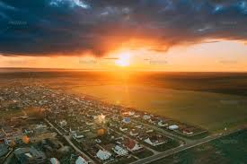
D. What is Faith?
1. Faith – Secular Notions
Christianity has always claimed that it has the story that explains everything else.
“I believe in Christianity as I believe that the Sun has risen, not only because I see it, but because by it I see everything else…I can say that, in my experience, it provides a coherent account of all the things which I find in the world and in myself.” (Lewis)

Slide 33
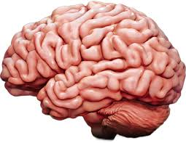
D. What is Faith?
2. Faith – what is isn’t.
Biblical faith is not mere mental assent.
James 2:18-20
18 But someone will say, “You have faith and I have works.” Show me your faith apart from your works, and I will show you my faith by my works. 19 You believe that God is one; you do well. Even the demons believe—and shudder!

Slide 34
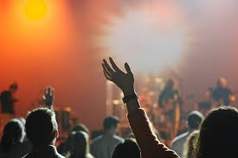
D. What is Faith?
2. Faith – what is isn’t.
Biblical faith not just a momentary decision.
Luke 8:13
And the ones on the rock are those who, when they hear the word, receive it with joy. But these have no root; they believe for a while, and in time of testing fall away.

Slide 35
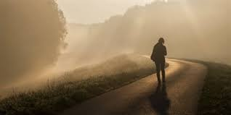
D. What is Faith?
3. Faith – what it is.
Lived Orientation according to the Story
Affirm its true; act accordingly; reason and plan according to the gospel reality.
Faith is faithfulness and perseverance
2 Thess 1:4 Therefore we ourselves boast about you in the churches of God for your steadfastness and faith in all your persecutions and in the afflictions that you are enduring.
Notes:
From Keat:
“What matters is not just one or two acts of obedience, but a lifetime of giving ourselves over to God. A lot of times the Greek word for ”faith” is translated as just “faith” but it also has the denotation of faithfulness. This means a sustained commitment to God and his Good News until the day we die. This is the ”day-in day-out” of the Christian life. In our pop culture today, we are told to move on from one fad to another, to find the next exciting concept, to come up with something creative and novel. However, that is not what God wants of us. He wants us to learn to be faithful to him, and this usually does not involve a lot of excitement. It involves doing the same things daily and weekly. Yet, this is what commitment means. In marriage you will only have one spouse and you are expected to be faithful to him. Marriage can be fun and exciting, but it is not fun and exciting everyday. Most of the time it is not. But what it demands is not fun and excitement but commitment, faithfulness, loyalty. This is what God expects of his people as well. “

Slide 36

D. What is Faith?
3. Faith – what it is.
Biblical faith can have doubts – who doesn’t?
e.g. Abraham’s life
Lies about wife being sister (Gen 12:10-20)
Laughs when God says son is coming (Gen 17:17)
But he ultimately acts out in faith till the end.
Notes:
Faith and doubt are not mutually exclusive.
Doubt arises when there is no complete understanding.
Faith doesn’t require complete understanding.

Slide 37

D. What is Faith?
3. Faith – what it is.
Biblical faith bridges gap between what we
i) formally believe and ii) functionally believe
There is always a gap between our espoused theology and our operational theology
We must learn to discern that gap
“The Christian Atheist is someone who believes in God but lives as if He doesn’t exist.”

Slide 38
D. What is Faith?
3. Faith – what it is.
Biblical faith bridges gap between what we
i) formally believe and ii) functionally believe
e.g. Peter’s hypocrisy
Galatians 2:11-14 But when Cephas came to Antioch, I opposed him to his face, because he stood condemned. 12 For before certain men came from James, he was eating with the Gentiles; but when they came he drew back and separated himself, fearing the circumcision party…

Slide 39
D. What is Faith?
3. Faith – what it is.
Biblical faith bridges gap between what we
i) formally believe and ii) functionally believe
…13 And the rest of the Jews acted hypocritically along with him, so that even Barnabas was led astray by their hypocrisy. 14 But when I saw that their conduct was not in step with the truth of the gospel, I said to Cephas before them all, “If you, though a Jew, live like a Gentile and not like a Jew, how can you force the Gentiles to live like Jews?”

Slide 40
D. What is Faith?
3. Faith – what it is.
Take home question:
What is the main gap between what you say you formally believe and what you functionally believe?

Slide 41
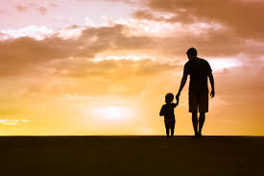
E. Who is Father Almighty?
1. Father
God is eternally Father
Not because we are his children
He is Father even without us
We come to know him as Father because Jesus Christ, His Son has made him known.
John 1:18 …the only God, who is at the Father’s side, he has made him known.
Matthew 11:27…no one knows the Father except the Son and anyone to whom the Son chooses to reveal him.

Slide 42
E. Who is Father Almighty?
1. Father
God is eternally Father
We can say God is like a mother but we cannot say God is mother.
Isaiah 49:15 Can a woman forget her nursing child, that she should have no compassion on the son of her womb? Even these may forget, yet I will not forget you.
Isaiah 66:13 As one whom his mother comforts, so I will comfort you; you shall be comforted in Jerusalem.
Notes:
Deuteronomy 32:18 You were unmindful of the Rock that bore you, and you forgot the God who gave you birth.
Matthew 23:37 How often would I have gathered your children together as a hen gathers her brood under her wings, and you were not willing!

Slide 43
E. Who is Father Almighty?
1. Father
God is eternally Father
Pressure to not use “Father”:
In this social environment that favors gender neutrality,
many are not comfortable with calling God Father.
Some feminist theologians have advocated not calling God as Father but merely as Creator/Source.
But Jesus revealed God as Father – we are not free to choose otherwise.

Slide 44
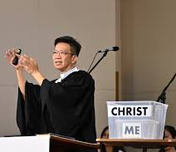
E. Who is Father Almighty?
1. Father
We are His children
Not by nature
But by adoption in Christ; We are only children by virtue of being in the Son by the Spirit.
Galatians 3:26 for in Christ Jesus you are all sons of God, through faith.
Rom 8:15 …you have received the Spirit of adoption as sons, by whom we cry, “Abba! Father!”

Slide 45
E. Who is Father Almighty?
2. Almighty
Almighty, Creator of heaven and earth
Echoes OT confession of God as Creator (2 Kgs 19:15; Psa 95; Exod 20:8–11; Deut 5:12–15)
‘heaven and earth’ – refers to all things (merism)
Against Gnosticism
Matter is evil, spirit is good.
The physical world was created by a lesser, ignorant, or even malevolent god (the Demiurge), not the true God.

