Slide 1
CREDO 2. ‘And in Jesus Christ His Only Son, Our Lord, who was conceived by the Holy Spirit, born of the Virgin Mary’
Notes:
‘

Slide 2
Previously on Credo 1.

Slide 3
‘I believe in God, the Father Almighty, Creator of heaven and earth.’
A. Why emphasise Creed today?
B. How was it used in Early Church?
C. Why this structure?
D. What is Faith?
E. Who is Father Almighty?

Slide 4
‘I believe in God, the Father Almighty, Creator of heaven and earth.’
C. Why this structure?
The Creed follows a structure
Trinitarian pattern: Father, Son, Spirit
Salvation Order: creation, redemption, consummation
Christological emphasis: Christ’s person and work

Slide 5
CREDO 2. ‘And in Jesus Christ His Only Son, Our Lord, who was conceived by the Holy Spirit, born of the Virgin Mary’
Notes:
When we look at Christology
- we look at person and work of Christ
- work of Christ is what he did suffered, died, resurrected, ascended (covered in the next 2 sessions)
- this week on person of Christ – his divine and human nature

Slide 6
Centrality of Christology
Know Christ = Know God
“No one knows the Father except the Son and anyone to whom the Son chooses to reveal him” (Matthew 11:27).
“Whoever has seen me has seen the Father” (John 14:9).
“the image of the invisible God” (Colossians 1:15).
Notes:
“No one knows the Father except the Son and anyone to whom the Son chooses to reveal him” (Matthew 11:27). In Christ the unseen God is made visible: “Whoever has seen me has seen the Father” (John 14:9). He is “the image of the invisible God” (Colossians 1:15). To know Christ is to know God.

Slide 7
Centrality of Christology
Seek Christ find Life
“I am the resurrection and the life. Whoever believes in me, though he die, yet shall he live” (John 11:25).
“The life was made manifest, and we have seen it” (1 John 1:2).
“and this life is in his Son” (1 John 5:11).
Notes:
Jesus said, “I am the resurrection and the life. Whoever believes in me, though he die, yet shall he live” (John 11:25). “The life was made manifest, and we have seen it” (1 John 1:2). God has given us eternal life, “and this life is in his Son” (1 John 5:11). To live in Christ is to live in God forever.
This doesn’t just concern professional theologians
True life as God intends is found in seeking Christ.

Slide 8
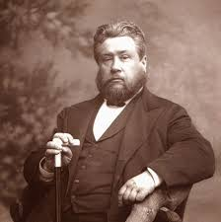
Centrality of Christology
“Christ is the sum and substance of the gospel; he is in himself all theology, the incarnation of every precious truth.”
Charles Spurgeon

Slide 9
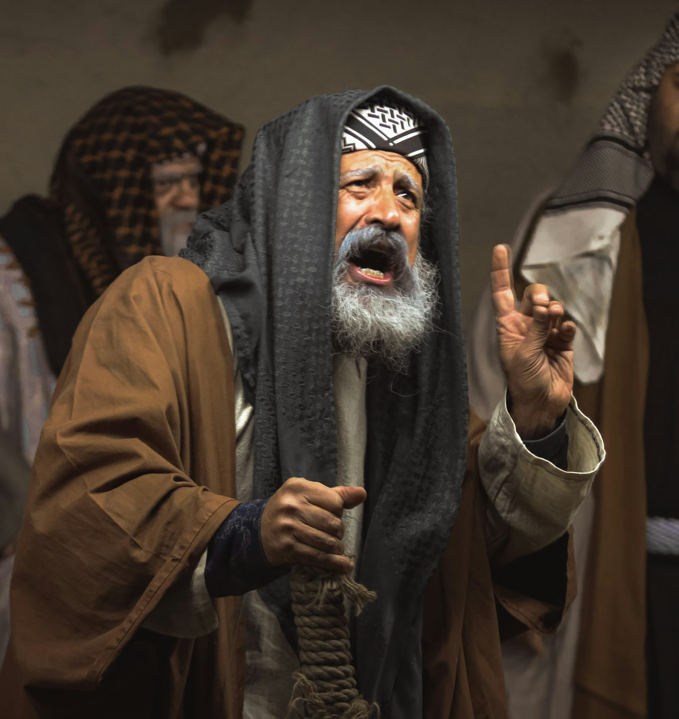
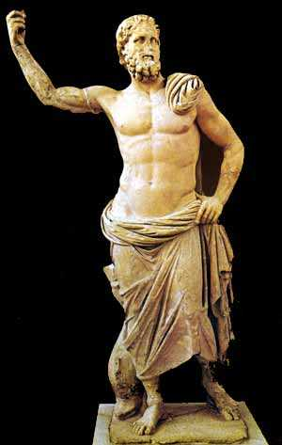
Imagine and Discuss (30mins)
A. What is at stake if we believed in the arguments of Shema People?
Why must we maintain that Jesus is fully divine?
B. What is at stake if they believed in the arguments of Truest Way Greek Church?
Why must we maintain that Jesus is fully human?
Notes:
Imagine and Discuss
It is the year 150 AD.
The Apostles are gone, and prominent leaders only pass through your region once every few years.
You are the shepherd of a young congregation, but you face intense pressures on every side.
On one hand, there is a Jewish synagogue nearby called Shema People.
They accuse you and your leaders of blasphemy.
To them, you are destroying monotheism by worshipping Jesus.
So crucial is monotheism to them that every morning and evening, they recite the Shema—“Hear, O Israel: the LORD our God, the LORD is one” (Deuteronomy 6:4).
But you Christians came along and say that Jesus of Nazareth is divine and to be worshipped.
They cannot comprehend how you can claim loyalty to the God of Israel while also worshipping Jesus as Lord.
They want you to leave the scene or change your belief of Jesus’ divine nature.
They argue: didn’t Jesus himself say, “concerning that day or that hour, no one knows, not even the angels in heaven, nor the Son, but only the Father” (Mark 13:32) – how then can Jesus be divine?
Meanwhile, just around the corner is a ‘Christian church’ called Truest Way Greek Church (TWGC).
They accuse you and your leaders of incoherence.
To them, you are destroying God’s purity by saying he took on flesh.
Even though they believe in the Christian God and the Apostles’ writings, they are also deeply influenced by Greek culture.
To them it is impossible that God took on flesh! Flesh is so disgusting – it leads to sexual immorality and all sorts of lewd passions.
Surely the divine Christ only appeared to be human, or perhaps he only temporarily “wore” a body like clothing.
They want you to leave the scene or tone town your belief of Jesus’ human nature.
They argue: didn’t Paul say that Jesus was merely ‘born in the likeness of men’ (Phil 2:7) – that is, he only took on something that is ‘like’ human but not fully human?
Your young congregation is confused. Some who are ethnically Jewish are confused by the Jewish synagogue nearby.
Others who were schooled in Greek philosophy, are wondering if there is a better way to square Christian beliefs with Greek philosophy.
Amidst this theological storm, the church leaders seek your wisdom to protect the sheep.
How will you explain to the congregation:
A. What is at stake if we believed in the arguments of Shema People? Why must we maintain that Jesus is fully divine?
B. What is at stake if they believed in the arguments of Truest Way Greek Church? Why must we maintain that Jesus is fully human?

Slide 10
Continued…
For mutual support, you meet with the leaders of other orthodox Christian congregations over a meal.
You discover that their congregations are facing similar pressures.

Slide 11
Continued…
For mutual support, you meet with the leaders of other orthodox Christian congregations over a meal.
You discover that their congregations are facing similar pressures.
One of them decides to conduct a CE class…

Slide 12
Give out handout.

Slide 13
OT Anticipates a Covenant Mediator
Covenant Lord = God
Covenant Partner = People of God
Notes:
Jesus is both covenant Lord and covenant partner anticipated by the Old Testament. As fully God, he comes as YHWH himself—the covenant Lord who redeems, commands, and restores his people (Isaiah 40:3; Malachi 3:1). As fully man, he stands within Israel’s story as the true covenant partner, fulfilling the vocation where Adam, Israel, and David failed (Romans 5:19; Isaiah 53). The two natures unite in one person so that Jesus both enacts God’s covenant promises and answers covenant obligations. Thus, only the God-man could secure the covenant relationship, uniting divine faithfulness with human obedience.
The Lord of the covenant must be God himself, since no creature can bring the new creation or forgive sins.
The partner in covenant must be truly human, since God’s covenant demands real obedience, suffering, and death on behalf of humanity.
The OT anticipates this paradox: YHWH will come to save (Isaiah 59:16–20), yet the Servant of the Lord will obey and suffer as Israel’s representative (Isaiah 42; 53).
Only in Christ—true God and true man—are covenant Lordship and partnership perfectly united.

Slide 14
OT Anticipates a Covenant Mediator
Covenant Lord = God
must be God himself, since no creature can bring the new creation or forgive sins.
YHWH himself must act —the covenant Lord who redeems, commands, and restores his people (Isaiah 40:3; Malachi 3:1)
Notes:
Jesus is both covenant Lord and covenant partner anticipated by the Old Testament. As fully God, he comes as YHWH himself—the covenant Lord who redeems, commands, and restores his people (Isaiah 40:3; Malachi 3:1). As fully man, he stands within Israel’s story as the true covenant partner, fulfilling the vocation where Adam, Israel, and David failed (Romans 5:19; Isaiah 53). The two natures unite in one person so that Jesus both enacts God’s covenant promises and answers covenant obligations. Thus, only the God-man could secure the covenant relationship, uniting divine faithfulness with human obedience.
The Lord of the covenant must be God himself, since no creature can bring the new creation or forgive sins.
The partner in covenant must be truly human, since God’s covenant demands real obedience, suffering, and death on behalf of humanity.
The OT anticipates this paradox: YHWH will come to save (Isaiah 59:16–20), yet the Servant of the Lord will obey and suffer as Israel’s representative (Isaiah 42; 53).
Only in Christ—true God and true man—are covenant Lordship and partnership perfectly united.

Slide 15
OT Anticipates a Covenant Mediator
Covenant Partner = People of God
OT records many failed covenant partners: Adam, Israel, and David
As fully man, Jesus stands within Israel’s story as the true covenant partner
This is because God’s covenant demands real human obedience, suffering, and death on behalf of humanity.
Notes:
Jesus is both covenant Lord and covenant partner anticipated by the Old Testament. As fully God, he comes as YHWH himself—the covenant Lord who redeems, commands, and restores his people (Isaiah 40:3; Malachi 3:1). As fully man, he stands within Israel’s story as the true covenant partner, fulfilling the vocation where Adam, Israel, and David failed (Romans 5:19; Isaiah 53). The two natures unite in one person so that Jesus both enacts God’s covenant promises and answers covenant obligations. Thus, only the God-man could secure the covenant relationship, uniting divine faithfulness with human obedience.
The Lord of the covenant must be God himself, since no creature can bring the new creation or forgive sins.
The partner in covenant must be truly human, since God’s covenant demands real obedience, suffering, and death on behalf of humanity.
The OT anticipates this paradox: YHWH will come to save (Isaiah 59:16–20), yet the Servant of the Lord will obey and suffer as Israel’s representative (Isaiah 42; 53).
Only in Christ—true God and true man—are covenant Lordship and partnership perfectly united.

Slide 16
OT Anticipates a Covenant Mediator
Covenant Lord = God
Covenant Partner = People of God
OT anticipates this paradox:
YHWH will come to save (Isaiah 59:16–20)
yet the Servant of the Lord will obey and suffer as Israel’s representative (Isaiah 42; 53)
OT anticipate one who is Fully Divine and Fully Human
Notes:
Jesus is both covenant Lord and covenant partner anticipated by the Old Testament. As fully God, he comes as YHWH himself—the covenant Lord who redeems, commands, and restores his people (Isaiah 40:3; Malachi 3:1). As fully man, he stands within Israel’s story as the true covenant partner, fulfilling the vocation where Adam, Israel, and David failed (Romans 5:19; Isaiah 53). The two natures unite in one person so that Jesus both enacts God’s covenant promises and answers covenant obligations. Thus, only the God-man could secure the covenant relationship, uniting divine faithfulness with human obedience.
The Lord of the covenant must be God himself, since no creature can bring the new creation or forgive sins.
The partner in covenant must be truly human, since God’s covenant demands real obedience, suffering, and death on behalf of humanity.
The OT anticipates this paradox: YHWH will come to save (Isaiah 59:16–20), yet the Servant of the Lord will obey and suffer as Israel’s representative (Isaiah 42; 53).
Only in Christ—true God and true man—are covenant Lordship and partnership perfectly united.

Slide 17
Plan for today.
Why must we maintain that Jesus is:
A. Fully Divine?
B. Fully Human?
C. How can the two be held together?
Notes:
What this session is about in nutshell
Explain Dialectics
- sovereignty and human freedom
- Cross – glory and shame
- Resurrection – new body but old scars
- submission and petition

Slide 18
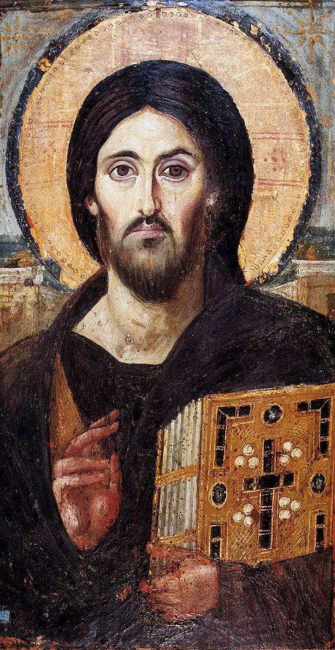
Fully Divine and Fully Human
Canon
Because Scripture Proclaims It
Consequence
Because Our Faith Depends on It

Slide 19
Plan for today.
Why must we maintain that Jesus is:
A. Fully Divine?
B. Fully Human?
C. How can the two be held together?

Slide 20
A. Fully Divine – Canon
Divine Names and Titles
“Lord” (kurios) - used in the Septuagint for Yahweh, the God of Israel (Philippians 2:9–11; Romans 10:9–13).
“God” (theos) – referred to Christ in (John 1:1, 18; John 20:28; Romans 9:5; Titus 2:13; and Hebrews 1:8. )
“Son of Man” – Jesus’ favorite self-designation (Daniel 7:13-14)
Notes:
The New Testament identifies Jesus with the divine name itself. “Lord” (kurios), often used in the Septuagint for Yahweh, is applied to Christ in ways that unmistakably equate him with the God of Israel (Philippians 2:9–11; Romans 10:9–13). Likewise, Jesus is directly called “God” (theos) in passages such as John 1:1, 18; John 20:28; Romans 9:5; Titus 2:13; and Hebrews 1:8. Such titles are not polite honorifics but confessions that Jesus shares the divine nature and authority.
Philippians 2:9–11 Therefore God has highly exalted him and bestowed on him the name that is above every name, so that at the name of Jesus every knee should bow, in heaven and on earth and under the earth, and every tongue confess that Jesus Christ is Lord, to the glory of God the Father.
Romans 10:9,13 If you confess with your mouth that Jesus is Lord and believe in your heart that God raised him from the dead, you will be saved… For “everyone who calls on the name of the Lord will be saved.
John 1:1 In the beginning was the Word, and the Word was with God, and the Word was God.
John 20:28 Thomas answered him, “My Lord and my God!”
Daniel 7:13–14 I saw in the night visions, and behold, with the clouds of heaven there came one like a son of man, and he came to the Ancient of Days and was presented before him. And to him was given dominion and glory and a kingdom, that all peoples, nations, and languages should serve him; his dominion is an everlasting dominion, which shall not pass away, and his kingdom one that shall not be destroyed.

Slide 21
A. Fully Divine – Canon
Divine Attributes
Fullness of deity in bodily form (Colossians 2:9).
Communicable attributes:
perfect love (Ephesians 5:2), righteousness (Acts 3:14), holiness (Hebrews 7:26), and truth (John 14:6).
Incommunicable attributes:
eternity (John 17:5), omnipotence (Philippians 3:21), omnipresence (Matthew 28:20), immutability (Hebrews 13:8), and omniscience (John 21:17).
Notes:
Jesus possesses the fullness of deity in bodily form (Colossians 2:9). He shares God’s communicable attributes—perfect love (Ephesians 5:2), righteousness (Acts 3:14), holiness (Hebrews 7:26), and truth (John 14:6). He also bears God’s incommunicable attributes: eternity (John 17:5), omnipotence (Philippians 3:21), omnipresence (Matthew 28:20), immutability (Hebrews 13:8), and omniscience (John 21:17). Scripture presents him as the imago Dei in the fullest sense, the very self-expression of God.
Colossians 2:9 For in him the whole fullness of deity dwells bodily.
John 14:6 Jesus said to him, “I am the way, and the truth, and the life. No one comes to the Father except through me.”
John 17:5 And now, Father, glorify me in your own presence with the glory that I had with you before the world existed.
Hebrews 13:8 Jesus Christ is the same yesterday and today and forever
John 21:17 Peter… said to him, “Lord, you know everything; you know that I love you.” Jesus said to him, “Feed my sheep.”

Slide 22
A. Fully Divine – Canon
Divine Works
Creates and sustains creation (Colossians 1:16–17; Hebrews 1:3).
Forgives sins with divine authority (Mark 2:10)
Raises the dead (John 11:25–26),
Executes judgment (John 5:22).
Pours out Spirit (Acts 2:33)
Inaugurates the kingdom of God (Mark 1:15; Matthew 12:28; Luke 17:21)
Notes:
Christ performs works that only God can do. He is the agent of creation and providence, sustaining all things by his powerful word (Colossians 1:16–17; Hebrews 1:3). He forgives sins with divine authority (Mark 2:10), raises the dead (John 11:25–26), and executes final judgment (John 5:22). He pours out the Holy Spirit (Acts 2:33) and inaugurates the kingdom of God, making present the realities of the new creation.
Colossians 1:16–17 For by him all things were created, in heaven and on earth, visible and invisible, whether thrones or dominions or rulers or authorities—all things were created through him and for him. And he is before all things, and in him all things hold together.
Hebrews 1:3 He is the radiance of the glory of God and the exact imprint of his nature, and he upholds the universe by the word of his power. After making purification for sins, he sat down at the right hand of the Majesty on high.
Mark 2:10 But that you may know that the Son of Man has authority on earth to forgive sins—he said to the paralytic…
John 11:25–26 Jesus said to her, “I am the resurrection and the life. Whoever believes in me, though he die, yet shall he live, and everyone who lives and believes in me shall never die. Do you believe this?”
John 5:22 For the Father judges no one, but has given all judgment to the Son.
Acts 2:33 Being therefore exalted at the right hand of God, and having received from the Father the promise of the Holy Spirit, he has poured out this that you yourselves are seeing and hearing.

Slide 23
A. Fully Divine – Canon
Divine Worship
Against backdrop of Jewish Monotheism
Jesus receives worship, prayer, and saving faith for Yahweh alone.
Disciples worship him without rebuke (Matthew 14:33; John 20:28). Church addresses him in prayer (Acts 7:59–60). To trust in Christ is to trust in God (John 14:1).
Notes:
Jesus receives worship, prayer, and saving faith that Scripture reserves for Yahweh alone. Disciples worship him without rebuke (Matthew 14:33; John 20:28), and the church addresses him in prayer (Acts 7:59–60). To trust in Christ is to trust in God (John 14:1).
Matthew 14:33 And those in the boat worshiped him, saying, “Truly you are the Son of God.”
John 20:28 Thomas answered him, “My Lord and my God!”
Acts 7:59–60 And as they were stoning Stephen, he called out, “Lord Jesus, receive my spirit.” And falling to his knees he cried out with a loud voice, “Lord, do not hold this sin against them.” And when he had said this, he fell asleep.
John 14:1 Let not your hearts be troubled. Believe in God; believe also in me.

Slide 24
A. Fully Divine – Consequence
Without Christ’s divinity
Salvation impossible
Worship blasphemes
Prayer pointless
Discipleship shrivels
Notes:
Salvation itself becomes impossible. A merely human Christ could not bear the infinite weight of divine wrath or provide everlasting righteousness (Daniel 9:24; Romans 3:21–22). Only the God-man could lay down his life with sovereign authority (John 10:17–18) and apply redemption universally (Romans 10:13). If Christ is not divine, the atonement is insufficient, judgment remains, and hope of eternal life evaporates
If Christ is not divine, worship collapses into idolatry, for singing, praying, and bowing before a mere man blasphemes God (Philippians 2:9–11).
Prayer becomes groundless, for calling upon Jesus’ name would be empty (Acts 7:59).
Discipleship shrivels, for the One who promises “I am with you always” (Matthew 28:20) would lack omnipresence.

Slide 25
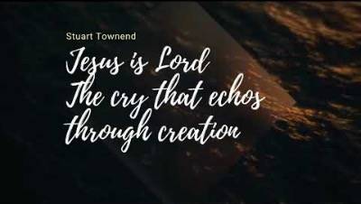
Jesus is Lord

Slide 26
Plan for today.
Why must we maintain that Jesus is:
A. Fully Divine?
B. Fully Human?
C. How can the two be held together?

Slide 27
B. Fully Human – Canon
Human Names and Identity
“man” (1 Tim 2:5)
“son of David” (Matt 1:1)
“son of Mary” (Mark 6:3)
Notes:
Scripture calls him man (1 Tim 2:5), son of David (Matt 1:1), and son of Mary (Mark 6:3), rooting him in real human lineage and history.
1 Timothy 2:5 For there is one God, and there is one mediator between God and men, the man Christ Jesus.
Matthew 1:1 The book of the genealogy of Jesus Christ, the son of David, the son of Abraham.
Mark 6:3 Is not this the carpenter, the son of Mary and brother of James and Joses and Judas and Simon? And are not his sisters here with us? And they took offense at him.

Slide 28
B. Fully Human – Canon
Human Limitations
hunger (Matt 4:2)
thirst (John 19:28)
fatigue (John 4:6)
growth (Luke 2:52),
ignorance (Mark 13:32).
Notes:
He took on flesh (John 1:14), with a body subject to hunger (Matt 4:2), thirst (John 19:28), fatigue (John 4:6), growth (Luke 2:52), and mortality (Luke 23:46). His mind could increase in knowledge and express limitation (Mark 13:32).
Ignorance
- Mark 13:32 But concerning that day or that hour, no one knows, not even the angels in heaven, nor the Son, but only the Father.
- Thinking according to his human nature instead of his divine nature.
- just like feeling hunger according to his human nature

Slide 29
B. Fully Human – Canon
Human Emotions
compassion (Matt 9:36)
joy (Luke 10:21)
sorrow (John 11:35),
anguish (Mark 14:34)
anger (Mark 3:5)
Notes:
He worked with human hands, traveled, prayed (Luke 6:12), and obeyed God’s law, learning obedience through suffering (Heb 5:8). He also felt compassion (Matt 9:36), joy (Luke 10:21), sorrow (John 11:35), anguish (Mark 14:34), and righteous anger (Mark 3:5).

Slide 30
B. Fully Human – Canon
Human Dependence on God
worshiped in the synagogue (Luke 4:16)
prayed in Gethsemane (Mark 14:35–36)
entrusted himself to God in death (Luke 23:46)
Notes:
Unlike his divine reception of worship, in his humanity Jesus depended on the Father: he worshiped in the synagogue (Luke 4:16), prayed in Gethsemane (Mark 14:35–36), and entrusted himself to God in death (Luke 23:46).

Slide 31
B. Fully Human – Consequence
Without Christ’s humanity:
No True Substitute or New Head
For as by the one man’s disobedience the many were made sinners, so by the one man’s obedience the many will be made righteous. (Romans 5:19)
Notes:
1.
No True Substitute
Sin entered the world through Adam, a man (Romans 5:12), and only a true man could undo Adam’s guilt. If Christ were not human, he could not stand in our place as the second Adam. God’s justice requires that the same nature which sinned must bear the penalty (Hebrews 9:22).
Romans 5:12
Therefore, just as sin came into the world through one man, and death through sin, and so death spread to all men because all sinned—
Hebrews 9:22
Indeed, under the law almost everything is purified with blood, and without the shedding of blood there is no forgiveness of sins.

Slide 32
B. Fully Human – Consequence
Without Christ’s humanity:
No Sympathetic Priest
Therefore he had to be made like his brothers in every respect, so that he might become a merciful and faithful high priest in the service of God, to make propitiation for the sins of the people. (Hebrews 2:17)
Notes:
2. Sympathetic Priest
The high priest had to represent the people, offering sacrifice on their behalf. Hebrews insists Christ “had to be made like his brothers in every respect” (Hebrews 2:17). Without a real body and blood, Christ could not fulfill the law, suffer death, or intercede effectively. Our Mediator would be absent.
Our Savior knows our frame because he shares it. He grew tired (John 4:6), wept (John 11:35), and faced temptation (Matthew 4:1–11). Without humanity, Christ could not sympathize with us (Hebrews 4:15). Believers would lose the comfort of a compassionate Lord who meets us in our weakness and suffering.
The high priest had to represent the people, offering sacrifice on their behalf. Hebrews insists Christ “had to be made like his brothers in every respect” (Hebrews 2:17). Without a real body and blood, Christ could not fulfill the law, suffer death, or intercede effectively. Our Mediator would be absent.
3.
No Sympathy in Weakness
Our Savior knows our frame because he shares it. He grew tired (John 4:6), wept (John 11:35), and faced temptation (Matthew 4:1–11). Without humanity, Christ could not sympathize with us (Hebrews 4:15). Believers would lose the comfort of a compassionate Lord who meets us in our weakness and suffering.

Slide 33
B. Fully Human – Consequence
Without Christ’s humanity:
No Resurrection Hope
But in fact Christ has been raised from the dead, the firstfruits of those who have fallen asleep. (1 Corinthians 15:20)
Notes:
Christ’s resurrection is the firstfruits of ours (1 Corinthians 15:20). Our hope of bodily resurrection and eternal life rests on the reality that he, in our nature, has already been raised.

Slide 34

Come Behold the Wondrous Mystery

Slide 35
Plan for today.
Why must we maintain that Jesus is:
A. Fully Divine?
B. Fully Human?
C. How can the two be held together?

Slide 36
C. How can the two be held together?
1. Historical Affirmation
The Chalcedonian Creed (451 AD)
2. Historical Error
Failure to maintain tension is fatal.

Slide 37
C. Held Together – Affirmation
Leading to Chalcedon
Since beginning: Jesus is Lord, worshipped with Father and Spirit
But errors arose: e.g. Arianism (‘there was a time when the Son was not’)
Nicene Creed (325 AD) (‘begotten not made’)
Notes:
Already in the time of the NT, the church confessed Jesus as Lord, worshiping him alongside the Father and the Spirit.
Yet articulating how he was both divine and human provoked intense debate.
But in the years to follow, after the Apostles died, various errors arose.
We will explore these more in the next portion.
But error which I mentioned last week was that of Arianism.
Arianism taught that the Son was a created being, not co-eternal with the Father, denying his full divinity and equality.
The Arians had a jingle: there was a time when he was not
To deal explicitly with this dangerous heresy, the Nicene Creed (325 – 1700 years ago) affirmed that the Son is “of one substance” (homoousios) with the Father, truly God from God.
It affirmed that yes – the Son is begotten but this begottenness is eternity, not in time.
Yet questions still remained: how exactly are the two natures held together?
Later on errors will appear that seem to
either divide Christ into two persons
or blurring the two natures into one, undermining both true divinity and true humanity.
These tensions led to the Council of Chalcedon (451).

Slide 38
C. Held Together – Affirmation
Leading to Chalcedon
Yet the question remained: how exactly are the two natures held together?
Later on errors will appear that seem to
either divide Christ into two persons
or blur the two natures into one,
These tensions led to the Council of Chalcedon (451).
Notes:
Already in the time of the NT, the church confessed Jesus as Lord, worshiping him alongside the Father and the Spirit.
Yet articulating how he was both divine and human provoked intense debate.
But in the years to follow, after the Apostles died, various errors arose.
We will explore these more in the next portion.
But error which I mentioned last week was that of Arianism.
Arianism taught that the Son was a created being, not co-eternal with the Father, denying his full divinity and equality.
The Arians had a jingle: there was a time when he was not
To deal explicitly with this dangerous heresy, the Nicene Creed (325 – 1700 years ago) affirmed that the Son is “of one substance” (homoousios) with the Father, truly God from God.
It affirmed that yes – the Son is begotten but this begottenness is eternity, not in time.
Yet questions still remained: how exactly are the two natures held together?
Later on errors will appear that seem to
either divide Christ into two persons
or blurring the two natures into one, undermining both true divinity and true humanity.
These tensions led to the Council of Chalcedon (451).

Slide 39
C. Held Together – Affirmation
The Chalcedonian Creed (451 AD)
Therefore, following the holy fathers, we all with one accord teach men to acknowledge
one and the same Son, our Lord Jesus Christ,
at once complete in Godhead and complete in manhood, truly God and truly man,
consisting also of a reasonable soul and body;
of one substance with the Father as regards his Godhead,

Slide 40
C. Held Together – Affirmation
The Chalcedonian Creed (451 AD)
6. and at the same time of one substance with us as regards his manhood;
7. like us in all respects, apart from sin;
8. as regards his Godhead, begotten of the Father before the ages,
9. but yet as regards his manhood begotten, for us men and for our salvation, of Mary the Virgin, the God-bearer;
10. one and the same Christ, Son, Lord, Only-begotten, recognized in two natures,

Slide 41
C. Held Together – Affirmation
The Chalcedonian Creed (451 AD)
a. without confusion,
b. without change,
c. without division,
d. without separation;
Notes:
No third nature through blending of the two.
Divinity didn’t absorb humanity; Humanity didn’t absorb divinity.
Not subtraction but addition.
Jesus Christ always sustains the universe – even after incarnation.
Christ is not divided into two persons, one divine and one human. It’s not that the divine Son does some things and the human Jesus does others, as though there were two acting subjects.
The union is permanent. The Son never abandons his humanity, even in death or exaltation.
Against any view that suggests the union was temporary, or that the divine Son could “depart” from the human Jesus.

Slide 42

C. Held Together – Affirmation
The Chalcedonian Creed (451 AD)
a. without confusion,
b. without change,
c. without division,
d. without separation;
Notes:
No third nature through blending of the two.
Divinity didn’t absorb humanity; Humanity didn’t absorb divinity.
Not subtraction but addition.
Jesus Christ always sustains the universe – even after incarnation.
Christ is not divided into two persons, one divine and one human. It’s not that the divine Son does some things and the human Jesus does others, as though there were two acting subjects.
The union is permanent. The Son never abandons his humanity, even in death or exaltation.
Against any view that suggests the union was temporary, or that the divine Son could “depart” from the human Jesus.

Slide 43
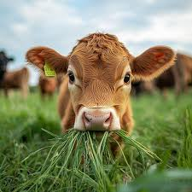
C. Held Together – Affirmation
The Chalcedonian Creed (451 AD)
a. without confusion,
b. without change,
c. without division,
d. without separation;
Notes:
No third nature through blending of the two.
Divinity didn’t absorb humanity; Humanity didn’t absorb divinity.
Not subtraction but addition.
Jesus Christ always sustains the universe – even after incarnation.
Christ is not divided into two persons, one divine and one human. It’s not that the divine Son does some things and the human Jesus does others, as though there were two acting subjects.
The union is permanent. The Son never abandons his humanity, even in death or exaltation.
Against any view that suggests the union was temporary, or that the divine Son could “depart” from the human Jesus.

Slide 44
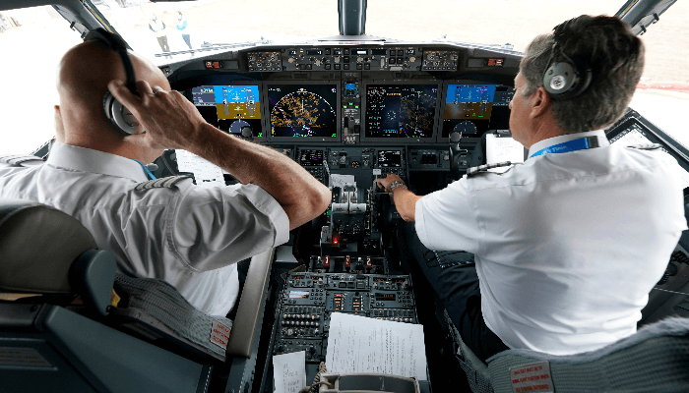
C. Held Together – Affirmation
The Chalcedonian Creed (451 AD)
a. without confusion,
b. without change,
c. without division,
d. without separation;
Notes:
No third nature through blending of the two.
Divinity didn’t absorb humanity; Humanity didn’t absorb divinity.
Not subtraction but addition.
Jesus Christ always sustains the universe – even after incarnation.
Christ is not divided into two persons, one divine and one human. It’s not that the divine Son does some things and the human Jesus does others, as though there were two acting subjects.
The union is permanent. The Son never abandons his humanity, even in death or exaltation.
Against any view that suggests the union was temporary, or that the divine Son could “depart” from the human Jesus.

Slide 45

C. Held Together – Affirmation
The Chalcedonian Creed (451 AD)
a. without confusion,
b. without change,
c. without division,
d. without separation;
Notes:
No third nature through blending of the two.
Divinity didn’t absorb humanity; Humanity didn’t absorb divinity.
Not subtraction but addition.
Jesus Christ always sustains the universe – even after incarnation.
Christ is not divided into two persons, one divine and one human. It’s not that the divine Son does some things and the human Jesus does others, as though there were two acting subjects.
The union is permanent. The Son never abandons his humanity, even in death or exaltation.
Against any view that suggests the union was temporary, or that the divine Son could “depart” from the human Jesus.

Slide 46
C. Held Together – Affirmation
The Chalcedonian Creed (451 AD)
11. the distinction of natures being in no way annulled by the union,
12. but rather the characteristics of each nature being preserved and coming together to form one person and subsistence,
13. not as parted or separated into two persons,
14. but one and the same Son and Only-begotten God the Word, Lord Jesus Christ;

Slide 47
C. Held Together – Affirmation
The Chalcedonian Creed (451 AD)
15. even as the prophets from earliest times spoke of him, and our Lord Jesus Christ himself taught us, and the creed of the fathers has handed down to us.

Slide 48
C. How can the two be held together?
1. Historical Affirmation
The Chalcedonian Creed (451 AD)
2. Historical Error
Failure to maintain tension is fatal.
Notes:
Explain that failure to hold tension leads to error
- sovereignty and human freedom
- submission and pertition
- Cross – glory and shame
- Resurrection – new body but old scars
BUT ESP true for Christology
So I will address these as pairs. Going into either ends.

Slide 49
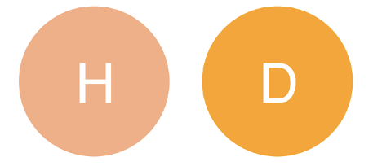
C. Held Together – Errors
Ebionism vs. Docetism
Jesus is just a human prophet specially blessed by God, not the eternal Son.
Jesus only seemed to have flesh and to suffer, but wasn’t really human.

Slide 50
C. Held Together – Errors
Ebionism vs. Docetism
CORRECTION!
“who was conceived by the Holy Spirit, born of the Virgin Mary” (Apostles’ Creed)
“at once complete in Godhead and complete in manhood, truly God and truly man” (Chalcedonian Creed)

Slide 51
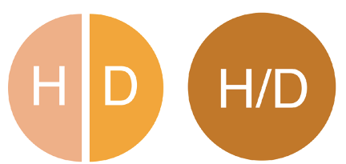
C. Held Together – Errors
Nestorianism vs. Eutychianism
Two-person Christ: Over-divides Christ’s two natures, almost making him two persons (human Jesus + divine Word loosely joined).
One-nature Christ: Over-blends Christ’s two natures into one mixed nature, neither fully human nor fully divine.

Slide 52
C. Held Together – Errors
Nestorianism vs. Eutychianism
CORRECTION!
a. without confusion,
b. without change,
c. without division,
d. without separation;
(Chalcedonian Creed)

Slide 53
C. Held Together – Errors
Tritheism vs. Modalism
F/S/HS
F
S
HS
Three Gods
Three Persons
One God
One (very adaptable) Person

Slide 54
C. Held Together – Errors
Tritheism vs. Modalism
F/S/HS
F
S
HS
CORRECTION!
Matthew 3:16-17
And when Jesus was baptized
…the Spirit of God descending like a dove
…a voice from heaven said, “This is my beloved Son, with whom I am well pleased.”

Slide 55
C. Held Together – Errors
Tritheism vs. Modalism
F/S/HS
F
S
HS
CORRECTION!
Matthew 28:19
...baptizing them in the name
of the Father and
of the Son and
of the Holy Spirit,

Slide 56
Epilogue…
It is the year 150 AD... Leaders from Shema People and TWGC are still disturbing your sheep.
Compared to your earlier response, what is one main thing you would emphasise to your young confused congregation to guard them?

Slide 57

In Christ Alone

