Slide 1
CREDO 3: Atonement ‘suffered under Pontius Pilate, was crucified, died, and was buried.’

Slide 2
Recapitulation
Why are creeds important?
Structure of the Apostles’ Creed
I believe – faith
Father Almighty, Creator of heaven and earth – immanent vs. transcendent
Jesus as fully God and fully man
Notes:
Creed comes from the Latin word Credo – which means I believe

Slide 3
I believe in God, the Father almighty, creator of heaven and earth.
I believe in Jesus Christ, his only Son, our Lord, who was conceived by the Holy Spirit and born of the virgin Mary. He suffered under Pontius Pilate, was crucified, died, and was buried; he descended to hell. The third day he rose again from the dead. He ascended to heaven and is seated at the right hand of God the Father almighty. From there he will come to judge the living and the dead.
I believe in the Holy Spirit, the holy catholic* church, the communion of saints, the forgiveness of sins, the resurrection of the body, and the life everlasting. Amen.

Slide 4
Recapitulation
Why are creeds important?
Structure of the Apostles’ Creed
I believe – faith
Father Almighty, Creator of heaven and earth – immanent vs. transcendent
Jesus as fully God and fully man
Notes:
Creed comes from the Latin word Credo – which means I believe

Slide 5
CREDO 3: Atonement ‘suffered under Pontius Pilate, was crucified, died, and was buried.’

Slide 6
Plan for today.
A. What are the different atonement theories?
B. Why did our church remove the clause ‘descended into hell’?

Slide 7
Atonement
The English word atonement literally comes from “at-one-ment.”
It was coined in Middle English to express the idea of reconciliation — bringing back together what was broken.
In Christian theology, it refers to how sinful humanity is made “at one” with a holy God through the life, death, and resurrection of Jesus Christ.

Slide 8
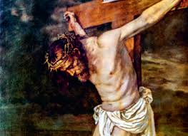
A. What are the different atonement theories?
Starter:
How did Jesus’ death bring about reconciliation between God and humanity?

Slide 9
A. What are the different atonement theories?
During what time period was the theory most popular?
What is the theory all about?
Illustration
Biblical basis
What gave rise to the theory?

Slide 10
A. What are the different atonement theories?
Penal Substitution
Traditionally associated with Reformers like Martin Luther, John Calvin (16th century Reformation)
Theological question: How can God forgive sin while remaining just and holy?
Christ bore the punishment we deserved, satisfying God’s justice so we could be forgiven.
Humans receive forgiveness not because of their own works but because Christ bore the penalty for sin.
Focus: Justice, punishment, and substitution

Slide 11
A. What are the different atonement theories?
Penal Substitution
Traditionally associated with Reformers like Martin Luther, John Calvin (16th century Reformation)
Biblical basis:
Isaiah 53:4-6 – He was pierced for our transgressions; the punishment that brings us peace was on Him.
2 Corinthians 5:21 – Christ became sin for us, so we might become righteous.
1 Peter 2:24 – He bore our sins in His body on the cross.

Slide 12
A. What are the different atonement theories?
Penal Substitution
Historical influence:
Protestant reformers were reacting against perceived abuses in the medieval Church (e.g., indulgences, sacramental overemphasis) and wanted a biblically grounded explanation of forgiveness.
The Reformation coincided with the rise of more structured nation-states and legal systems in Europe. Law courts, written statutes, and codified legal reasoning provided a natural metaphor for explaining how God deals with sin and righteousness.

Slide 13
A. What are the different atonement theories?
Christus Victor
Patristic Era/early Church Fathers (2nd – 5th centuries): Irenaeus, Athanasius, Gregory of Nyssa
Theological question: How to defeat sin, death and demonic powers?
In a cosmic battle, Jesus conquers the forces enslaving humanity through his death and resurrection.
Forgiveness is part of liberation; salvation is deliverance from bondage to sin and death.
Focus: Cosmic triumph, liberation, and resurrection

Slide 14
A. What are the different atonement theories?
Christus Victor
Patristic Era/early Church Fathers (2nd – 5th centuries): Irenaeus, Athanasius, Gregory of Nyssa
Biblical basis:
Colossians 2:13-15 – Christ disarms the powers and triumphs over them.
1 Corinthians 15:54-57 – Death is swallowed up in victory; Christ conquers.
Hebrews 2:14-15 – Christ destroys the power of death and liberates humanity from fear.

Slide 15
A. What are the different atonement theories?
Christus Victor
Patristic Era/early Church Fathers (2nd – 5th centuries): Irenaeus, Athanasius, Gregory of Nyssa
Historical influence:
Early Christians were influenced by Jewish and Greco-Roman ideas of cosmic struggle and liberation.
Persecution and martyrdom – therefore, Christ’s victory over oppressive powers made liberation imagery powerful and relatable.

Slide 16
A. What are the different atonement theories?
Satisfaction Theory
Anselm of Canterbury (11th century)
Theological question: Human sin dishonours God’s infinite majesty. Humanity cannot restore this honour on its own. So how?
By His death, Christ satisfies God’s honour on behalf of humanity.
Focus: Sin, honour, and satisfaction — something “owed” to God is met in Christ

Slide 17
A. What are the different atonement theories?
Satisfaction Theory
Anselm of Canterbury (11th century)
Biblical basis:
Romans 1:21 – For although they knew God, they did not honour him as God or give thanks to him
Romans 3:23 – All have sinned and fallen short of the glory of God.
Romans 5:19 – Through the disobedience of one man (Adam), many were made sinners, but through the obedience of one man (Christ), many would be made righteous.

Slide 18
A. What are the different atonement theories?
Satisfaction Theory
Anselm of Canterbury (11th century)
Historical influence:
Feudalism where honour was central — if a vassal dishonoured his lord, satisfaction or restitution was required.
By the 11th century, Satan’s rights over humanity seemed less convincing in a society with stronger institutions of justice.

Slide 19
A. What are the different atonement theories?
Satisfaction Theory
Anselm of Canterbury (11th century)
Satisfaction theory is the medieval precursor to Penal Substitution. Both involve Christ bearing the consequences of sin to satisfy God’s justice, but Penal Substitution emphasises the legal/penal aspect more.

Slide 20
A. What are the different atonement theories?
Moral influence
Peter Abelard (12th century)
Theological question: How could a loving God require suffering for forgiveness?
Humanity’s main problem is not God’s wrath or divine justice needing satisfaction, but our alienation from God caused by ignorance, fear, and mistrust.
Sin carries its own consequences.

Slide 21
A. What are the different atonement theories?
Moral influence
Peter Abelard (12th century)
Christ’s life, teachings, and especially His self-giving love on the cross, serve as the supreme demonstration of God’s love.
This display of love awakens in us repentance, gratitude, and love for God, reconciling us relationally.
Focus: Love, human response, moral transformation

Slide 22
A. What are the different atonement theories?
Moral influence
Peter Abelard (12th century)
Biblical basis:
John 15:13 – Greater love has no one than to lay down one’s life for friends.
Romans 5:8 – Christ demonstrates God’s love toward us while we were sinners.
1John 4:19 – We love because he first loved us.

Slide 23
A. What are the different atonement theories?
Moral influence
Peter Abelard (12th century)
Historical influence:
Reaction against the harsh images of God seen in Satisfaction Theory; instead of focusing on divine wrath, Abelard emphasised human responsibility to respond in love once God’s love is revealed.
Growing emphasis on God’s love rather than wrath, influenced by scholastic humanism and pastoral concerns.

Slide 24
A. What are the different atonement theories?
Moral influence
Peter Abelard (12th century)
Historical influence:
12th-century spirituality was deeply shaped by the monastic movement (e.g., Bernard of Clairvaux).
There was strong emphasis on God’s love, intimacy, and the believer’s affective response (love, devotion, tears, longing).

Slide 25
A. What are the different atonement theories?
Governmental Theory
Hugo Grotius (17th century)
Theological question: How can God forgive sin without violating justice?
Christ’s death serves as a public demonstration that sin has consequences; God does not require the exact punishment for each sin but the moral order is upheld.
Focus: Moral order, deterrence, and governance

Slide 26
A. What are the different atonement theories?
Governmental
Hugo Grotius (17th century)
Biblical basis:
Romans 3:25–26 – “God presented Christ as a sacrifice of atonement, through the shedding of his blood – to be received by faith. He did this to demonstrate his righteousness, because in his forbearance he had left the sins committed beforehand unpunished. He did it to demonstrate his justice at the present time, so as to be just and the one who justifies those who have faith in Jesus.”
Galatians 6:7 – “Do not be deceived: God is not mocked, for whatever one sows, that will he also reap.”

Slide 27
A. What are the different atonement theories?
Governmental Theory
Hugo Grotius (17th century)
Historical influence:
Early modern Europe, post-Reformation, in a culture grappling with justice, mercy, and the moral order of society.
Grotius’ view reflects rationalist and natural law thinking prominent in 17th-century Europe.
Reaction against rigid Penal Substitution ideas that seemed harsh or mechanical.

Slide 28
Theory | Story Illustration | Key Idea
Christus Victor | Son defeats enemy and frees captured children | Christ conquers sin, death, evil
Satisfaction | Knight dishonours king; king’s son restores honour | Christ satisfies God’s honour
Moral Influence | Parent saves child; child is inspired | Christ’s love transforms hearts
Penal Substitution | Friend pays fine for lawbreaker | Christ bears our penalty
Governmental | The child who lies learns that dishonesty has its consequences; family rules are upheld | Christ demonstrates seriousness of sin, maintains moral order

Slide 29
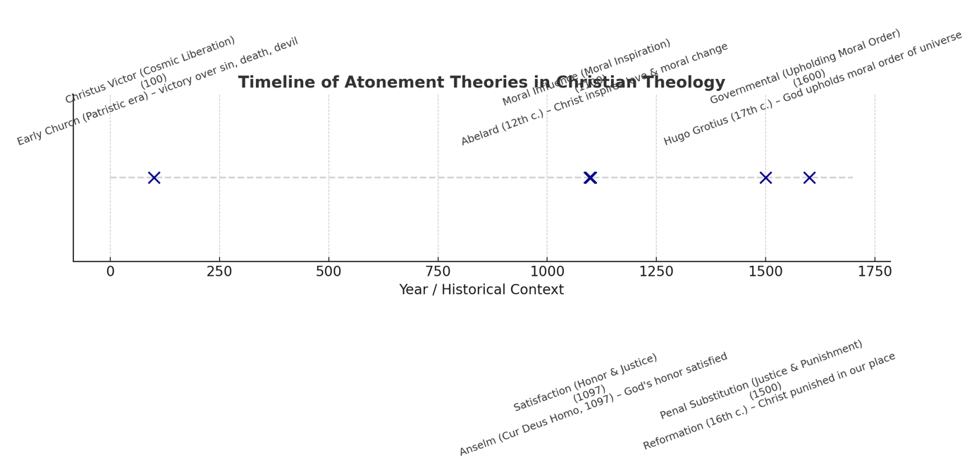

Slide 30
Which of the first 5 theories is this most closely connected to?
Ransom theory
Satan conquered Adam and thus became the rightful owner of him and his posterity. Hence, he is called the god and prince of this world.
To deliver men from this dreadful bondage, Christ offered Himself as a ransom to Satan. Satan accepted the offer and renounced his right to retain mankind as his slaves.
Christ, however, broke the bonds of Satan. Christ being divine, and without sin, could not be held subject to his power.

Slide 31
Which of the first 5 theories is this most closely connected to?
Expiation theory
Humanity’s central problem is guilt and defilement before God.
Sin needs to be covered, cleansed, or wiped away so that fellowship with God can be restored.
Christ’s death provides the means by which our sins are removed.

Slide 32
Which of the first 5 theories is this most closely connected to?
Propitiation theory
Through Jesus’ death, God’s righteous anger against sin is turned away (propitiated), so that His favour rests on us instead of His judgment.
Not only is sin removed (expiation), but God’s wrath is satisfied.

Slide 33
Which of the first 5 theories is this most closely connected to?
IV. Scapegoat Theory
Draws on the biblical imagery of the scapegoat in Leviticus 16, where, on the Day of Atonement (Yom Kippur), the high priest symbolically placed the sins of Israel onto a goat, which was then sent into the wilderness, carrying away the people’s guilt.
Less about an exact one-to-one transaction of punishment and more about how sin is dealt with for the sake of order, justice, and community stability.

Slide 34
Penal Substitution = Jesus bears the penalty of sin (justice satisfied).
Expiation = Jesus removes the guilt/defilement of sin (cleansing).
Propitiation = Jesus turns away God’s wrath (relational reconciliation).
Scapegoat = Jesus carries sin away (removal, corporate imagery).

Slide 35
Concluding remarks
These atonement theories were very much influenced by the historical and cultural contexts of their times.
Sometimes, the proponents were responding to other theories which didn’t sit well with them.
A particular theory should not be presented as a standalone explanation but as one dimension of a fuller atonement theology.

Slide 36
And can it be
And can it be that I should gain An int'rest in the Savior's blood? Died He for me, who caused His pain? For me, who Him to death pursued? Amazing love! how can it be That Thou, my God, should die for me?
Refrain: Amazing love! how can it be That Thou, my God, should die for me!

Slide 37
Nothing but the blood
What can wash away my sin? Nothing but the blood of Jesus; What can make me whole again? Nothing but the blood of Jesus.
Refrain: Oh! precious is the flow That makes me white as snow; No other fount I know, Nothing but the blood of Jesus.

Slide 38
In Christ alone
In Christ alone, who took on flesh Fullness of God in helpless babe This gift of love and righteousness Scorned by the ones He came to save 'Til on that cross as Jesus died The wrath of God was satisfied For every sin on Him was laid Here in the death of Christ I live, I live

Slide 39
In Christ alone
There in the ground His body lay Light of the world by darkness slain Then bursting forth in glorious Day Up from the grave He rose again And as He stands in victory Sin's curse has lost its grip on me For I am His and He is mine Bought with the precious blood of Christ

Slide 40
My living hope
Who could imagine so great a mercy? What heart could fathom such boundless grace? The God of ages stepped down from glory To wear my sin and bear my shame The cross has spoken, I am forgiven The king of kings calls me His own Beautiful savior, I'm Yours forever Jesus Christ, my living hope

Slide 41
My living hope
Hallelujah, praise the One who set me free Hallelujah, death has lost its grip on me You have broken every chain There's salvation in Your name Jesus Christ, my living hope

Slide 42
Pause.

Slide 43
CREDO 3: Atonement ‘suffered under Pontius Pilate, was crucified, died, and was buried; he descended into hell.’

Slide 44
B. Why did we remove the clause ‘he descended into hell’?
It started off as a phrase which we had to constantly explain to people that Christ didn’t descend into hell, and that the Latin word was more accurately translated as ‘the dead’.
Unlike the Nicene Creed, the Apostles' Creed was not written or approved by a single Church council at one specific time. Rather, it gradually took shape from about A.D. 200 to 750.
The clause was not found in any of the early versions of the Creed until it appeared in one of two versions from Rufinus in A.D. 390. Then it is not included again in any version of the Creed until 650.

Slide 45
Hebrew Understanding of the Place of the Dead
In the OT, when someone died, he would go to the place of the dead, Sheol in Hebrew, and translated in Greek as Hades.
¹⁰For you will not abandon my soul to Sheol, or let your holy one see corruption.
¹¹ You make known to me the path of life; in your presence there is fullness of joy; at your right hand are pleasures forevermore. (Ps 16)

Slide 46
Hebrew Understanding of the Place of the Dead
In the NT, Jesus told the thief, “Today, you will be with me in paradise” (Lk. 23:43); he also spoke about Abraham’s bosom in the parable of the rich man and Lazarus (Lk. 16:22-23).
¹The fifth angel sounded his trumpet, and I saw a star that had fallen from the sky to the earth. The star was given the key to the shaft of the Abyss. ² When he opened the Abyss, smoke rose from it like the smoke from a gigantic furnace. The sun and sky were darkened by the smoke from the Abyss. (Rev 9)

Slide 47
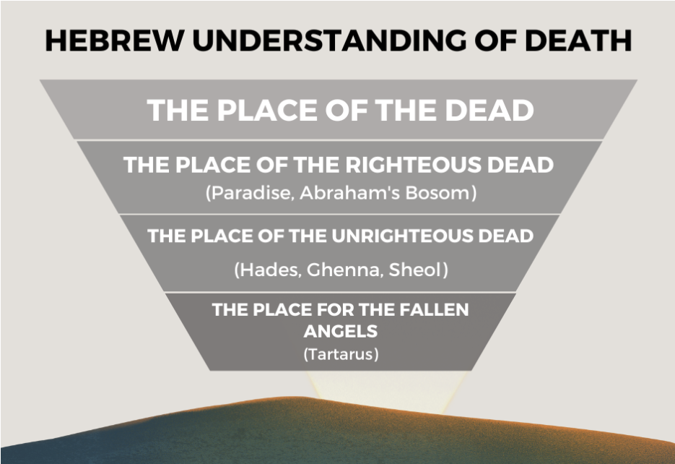

Slide 48
Patristic Fathers did not confess the descent clause
The Patristic Fathers believed in Christ descending to the dead.
“He was laid in the tomb, and He descended into Hades alone; but He arose accompanied by a multitude, for He went down to the regions beneath the earth, not alone, but taking with Him all the righteous.” Hippolytus of Rome (c. 170–235)

Slide 49
Patristic Fathers did not confess the descent clause
“The Word of God descended even into the depths of the earth, in order that, having been made manifest even to the dead, and having loosed the pains of death, He might become the First-born from the dead, and Lord of both the dead and the living.” Athanasius of Alexandria (c. 296–373)
The Patristic Fathers believed in Christ descending to the dead. They did not confess it in the Apostles’ Creed because it was seen as already being confessed in the clause “he was buried”.

Slide 50
Churches who insisted on confessing the descent clause
There were churches who viewed the burial clause as including the descent; they therefore did not have a further and more explicit descent clause.
Those who insisted on confessing the descent clause viewed the human body as being buried in a tomb while the human soul departed to the place of the dead as two distinct realities.

Slide 51
Churches who insisted on confessing the descent clause
Jesus’ soul went to the place of the dead to do two things:
To declare victory over Satan, death and sin.
To liberate the righteous dead
Abraham’s bosom/paradise before the cross = a place of waiting.
Paradise after the cross = heaven itself, in God’s immediate presence.

Slide 52
Threat of Apollinarianism
It is also interesting to note that when the descent clause was first inserted in 390 AD and then later in 650 AD, it was to deal with the threat of Apollinarianism.
Apollinaris wanted to defend Christ’s full divinity against Arianism (which denied it).
But in doing so, he explained the incarnation by saying that in Jesus:
The divine Logos (Word of God) took the place of the human rational soul/mind (nous).
So Christ had a human body and human emotions, but not a fully human soul.

Slide 53
Human being
=
Body
+
Soul
+
Mind
Soul

Slide 54
Human being
=
Body
+
Soul
+
Logos
Not a fully human soul

Slide 55
How does the descent clause counter Apollinarianism?
Christ had a true human soul that experienced death.
At the crucifixion, Christ’s human body was buried, and His human soul descended to the realm of the dead.
If Christ had no human soul, what would have “descended” to the dead?
The Creed insists He experienced the full reality of human death, not just in His body but also in His soul.

Slide 56
How does the descent clause counter Apollinarianism?
Christ’s solidarity with humanity is complete.
All humans die, and their souls go to the place of the dead.
By confessing that Christ descended there, the Creed affirms He entered the full human condition, including the fate of the soul after death.
This requires a complete humanity (body + rational soul).
Christ saves the whole human, body and soul.

Slide 57
B. Why did we remove the clause ‘he descended to hell’?
If today, we no longer have to deal with Apollinarianism, does that mean there is lesser urgency to confess the descent clause?
Can we adopt the Patristic Fathers’ understanding that the descent clause is subsumed under the clause “he was buried”?
If the descent clause was originally not there, can we stick with the original version?

